Slide 1
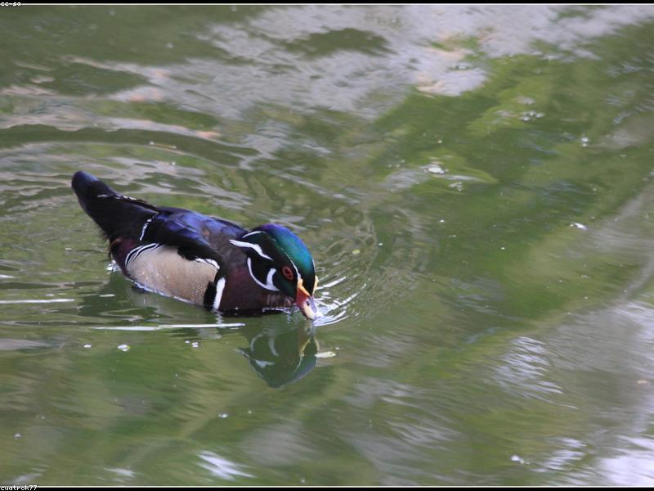
Types of Ducks
- Overview of various duck species
- Characteristics of mallards
- Wood duck habitat
- Differences between domestic and wild ducks
- Importance of ducks in ecosystems

Slide 2
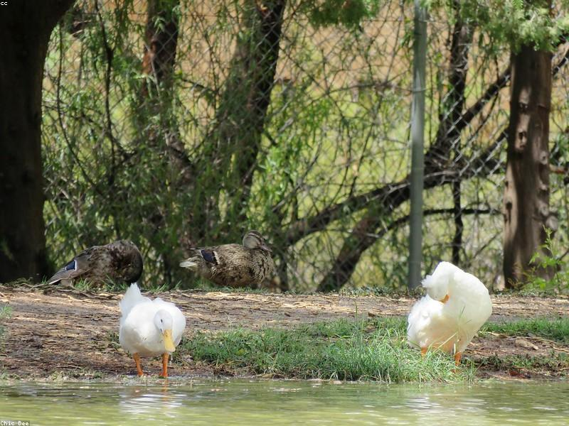
Duck Behavior
- Social behavior of ducks
- Feeding habits and diet
- Nesting and breeding practices
- Migration patterns
- Communication methods among ducks

Slide 3
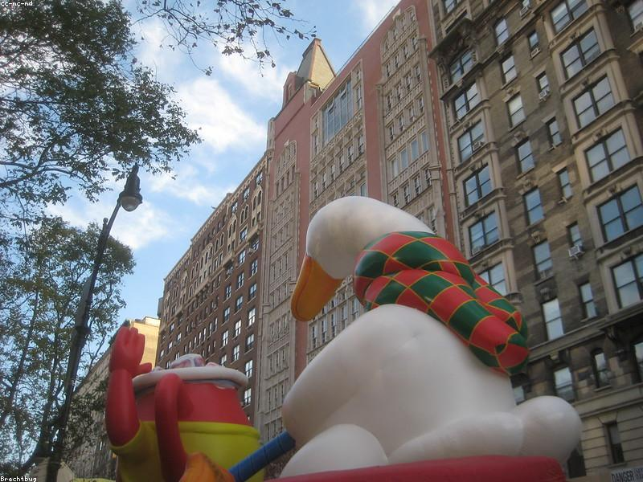
Ducks in Culture
- Ducks in folklore and stories
- Representation in media and cartoons
- Duck hunting traditions
- Conservation efforts for ducks
- Ducks as pets

Slide 4

Duck Conservation
- Importance of wetland habitats
- Threats to duck populations
- Conservation programs and initiatives
- Role of organizations in duck preservation
- How individuals can help

Slide 5
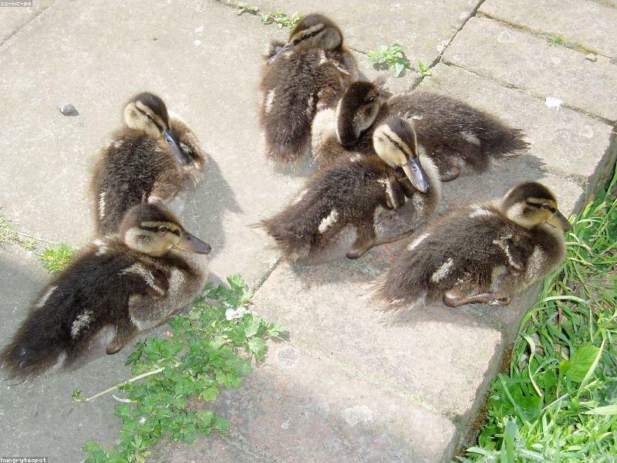
Fun Facts About Ducks
- Unique facts about ducks
- Lifespan and growth of ducklings
- Quacking vs. non-quacking ducks
- Cultural significance of ducks
- Interesting duck trivia

